Slide 1
Toward Driving Scene Understanding: A Dataset for Learning Driver Behavior and Causal Reasoning
作者：Vasili Ramanishka, Yi-Ting Chen, Teruhisa Misu, Kate Saenko
来源：CVPR18
汇报人：郝磊祯 19210240221
Notes:
今天给大家分享2018年cvpr的一篇文章。这篇文章里面工作可能对我们实现自动驾驶level4提供新的解题思路

Slide 2
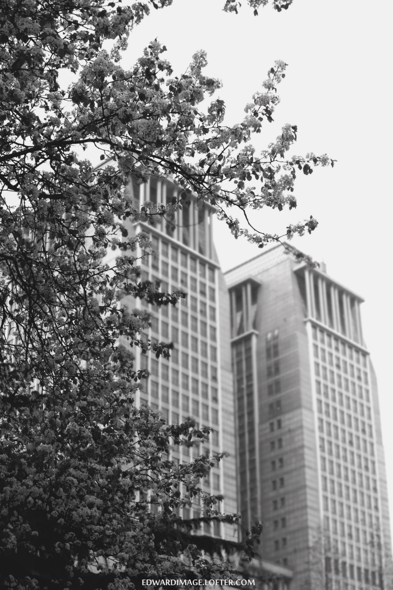
引 言
1

Slide 3
Background
Level 5
Level 4
美国汽车工程师学会(Society of Automotive Engineers， SAE)将自动驾驶分为了5个级别
Level 3
Level 2
Level 1
Level 0
Notes:
先简要回顾一下人类在实现自动驾驶这条路上走了多远，都做了哪些工作。Level 0:毫无自动控制功能，四个轮子+一个沙发。这种车是很危险的，速度稍微一起来的情况下，你一脚踩下刹车踏板，车轮抱死打滑，这样会出现很多安全问题。为了解决这个问题，我们给车安上了很多 现在听起来理所当然天经地义的必备的功能：ABS防抱死系统，ESP车身电子稳定系统，更高级一点的还有 在高速公路上比较适合使用的巡航功能（脚一直踩着油门多累呀）。这样我们进入了Level1阶段。那有人会提出，既然双脚已经解放，我方向盘也不想碰了，行不行？行！18年有许多公司已经量产了可以具备大撒把的车。但依旧很有局限性，仅仅做到维持车道和保持车距，也不具备变道超车的功能，这个状态就属于level2。特斯拉为什么说是2.5呢，因为虽然它具备一定的变道功能，但是判断变道环境是否安全的任务还是交给人判断的，如果安全，人为拨动转向杆，汽车拿到该信号后实现换道，也就是说它把环境感知的模块交给了人。目前L3只有奥迪独一家，看起来功能和L2的一样。那么L2和L3的区别在哪里呢？L2司机始终是司机，需要实时监视路况，凯迪拉克那款会实时扫描人脸确定你的注意力是否在路上，但是奥迪A8方向盘前的人可以由司机转换成乘客的角色。当系统提示需要接管时，才需要你进行切换回司机的角色。

Slide 4
Background
1. The performance of visual scene recognition tasks has been significantly boosted by recent advances of deep learning algorithms .
2. An increasing number of benchmark datasets.
Notes:
深度学习的蓬勃发展和较好的图像识别取得较好效果

Slide 5
Background
1
These datasets do not address many of the challenges in the higher level driving scene understanding.
Views of author
1
detecting traffic participants is only the first step.
2
we need to understand the interactions between human driver behaviors and the corresponding traffic scene situations

Slide 6
论文讲解
2

Slide 7
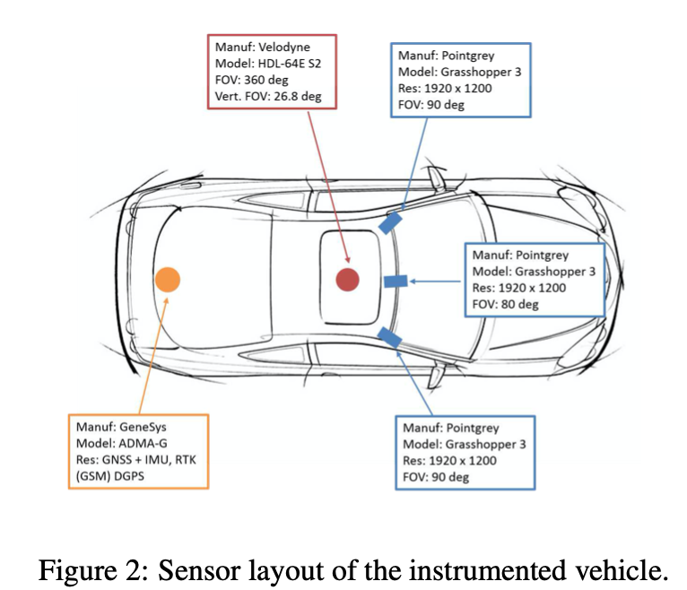
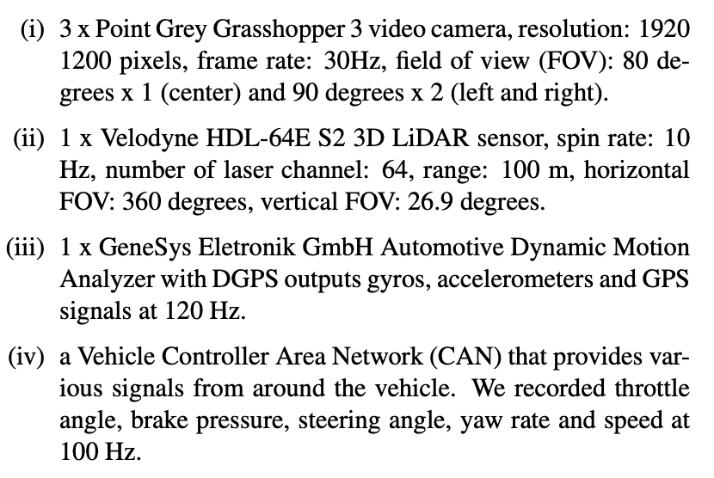
1
Collecting Data
collected 104 hours of real human driving in the San Francisco Bay Area

Slide 8
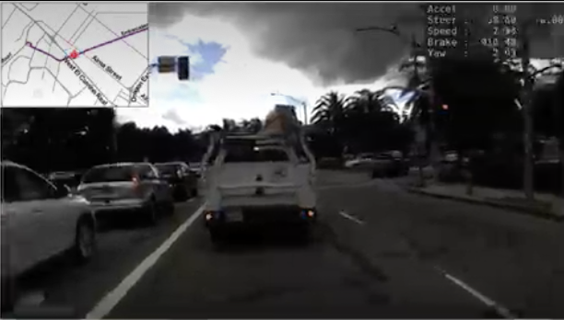
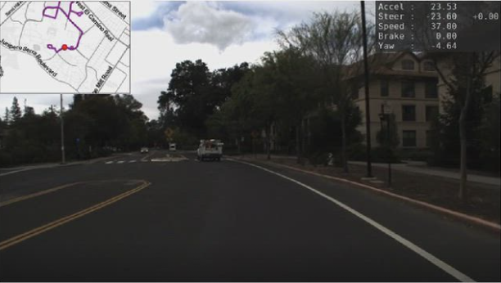
Lane branch
Merge
collected 104 hours of real human driving in the San Francisco Bay Area

Slide 9
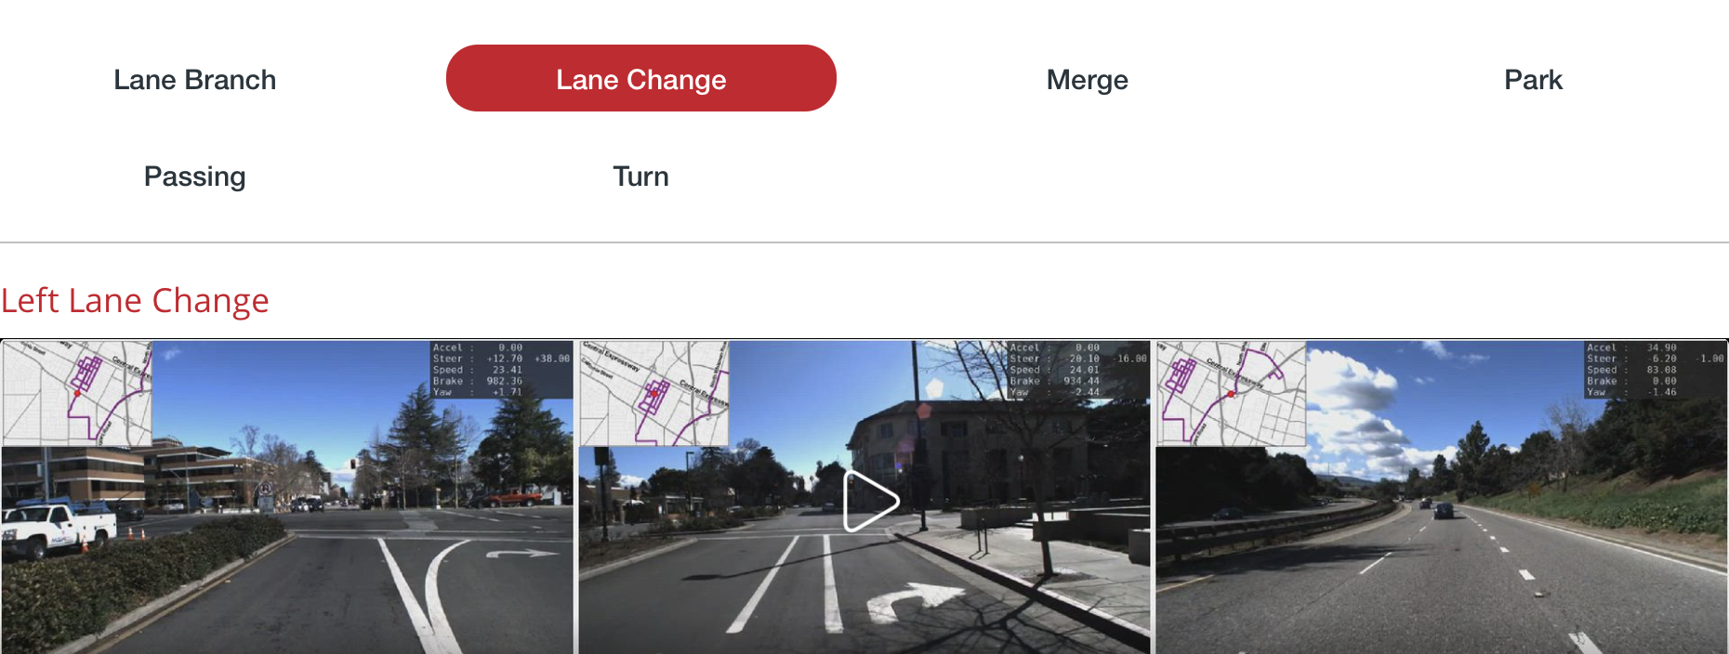
The recording consists of 137 sessions, and each session represents a navigation task performed by a driver.

Slide 10
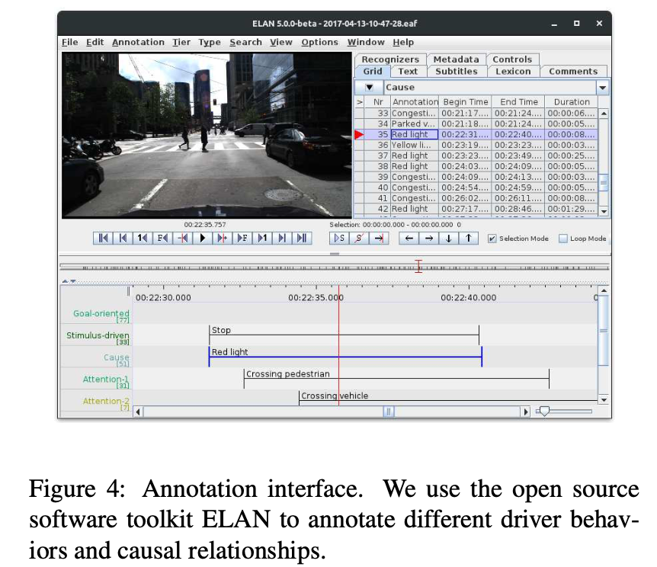
2
Annotation Methodology
Our annotation methodology is motivated by human factor and cognitive science.
We propose a 4-layer representation to describe driver behavior.Goal-oriented action(green), Stimulus-driven action(red), Cause and Attention(purple)

Slide 11
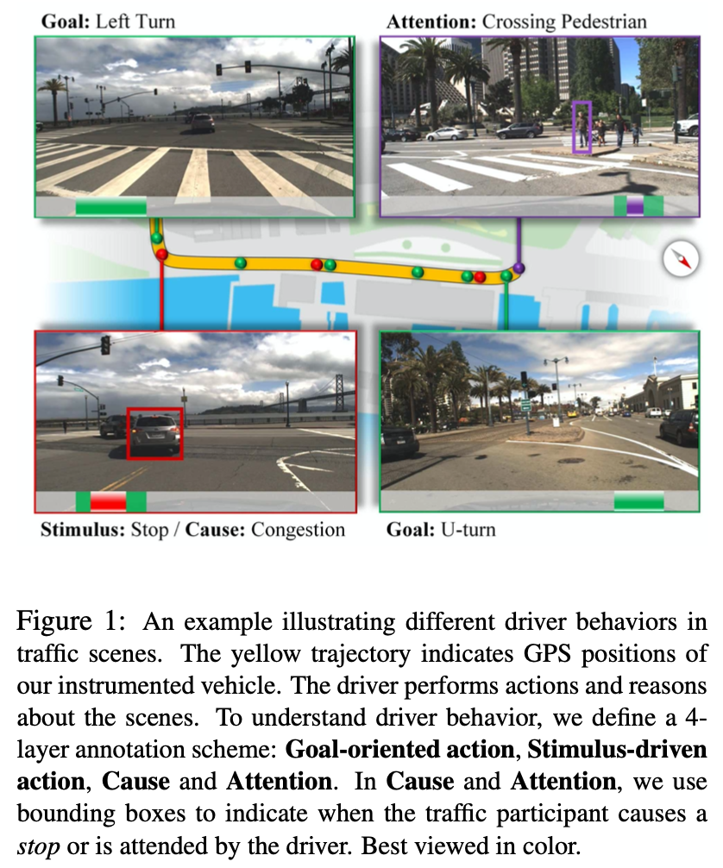
The yellow trajectory indicates GPS positions of our instrumented vehicle
Goal-oriented action(Green): involves the driver’s manipulation of the vehicle in a navigation task such as right turn, left turn, branch and merge.
Stimulus-driven action (Red): While operating the vehicle, the driver can make a stop or deviate due to traffic participants or obstacles. Stop and deviate are categorized as Stimulus- driven action.
Cause (red):While operating the vehicle, the driver can make a stop or deviate due to traffic participants or obstacles. Stop and deviate are categorized as Stimulus- driven action.
Attention(purple):Localize the traffic participants that are attended by drivers. For example, a pedestrian near ego lane may be attended by drivers since the pedestrian might perform certain actions that would affect driver behavior.

Slide 12
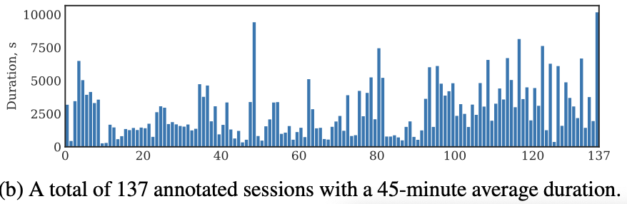
Dataset Statistics
The average duration of each session is 45 minutes.

Slide 13
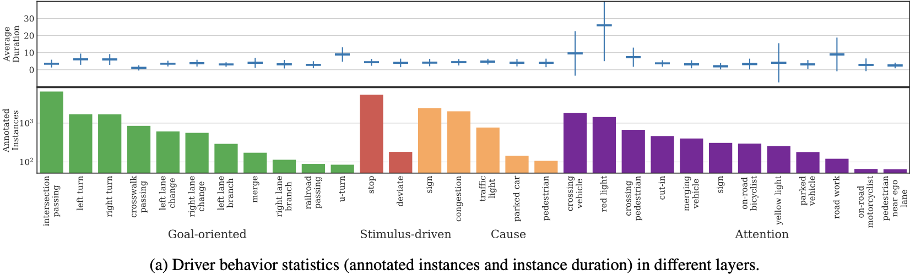
Dataset Statistics
Within 104 video hours, we have 137 sessions corresponding to different navigation tasks.

Slide 14
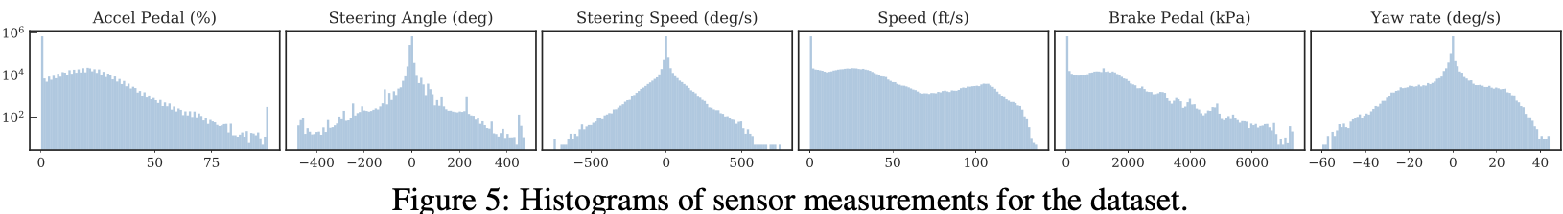
In addition to the input video stream, our model has access to an auxiliary signal which provides complimentary information about the vehicle dynamics
From the CAN bus sensors: car speed, accelerator and braking pedal positions, yaw rate, steering wheel angle, and the rotation speed of the steering wheel

Slide 15
实 验
3

Slide 16
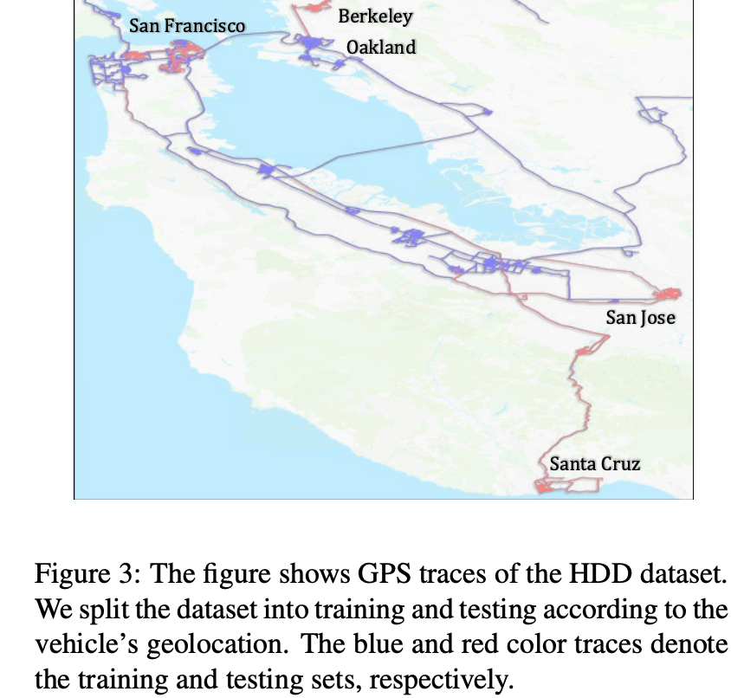
1
训练集(blue)
2
测试集(red)
We split the dataset based on the geolocation data, thus, minimizing spatial overlap of train and test routes. This way we avoid testing on the very same locations as those used to train the model.

Slide 17
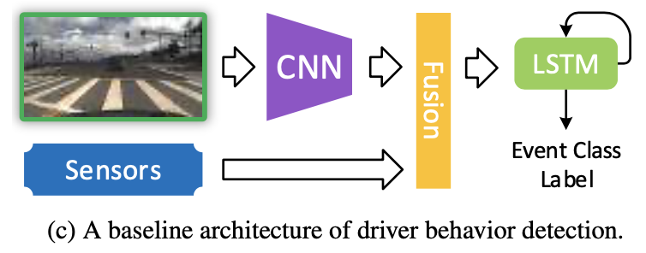
Long-Short Term Memory (LSTM) networks were shown to be successful in many temporal modeling tasks, including activity detection. We thus employ an LSTM as the backbone architecture for our model.

Slide 18
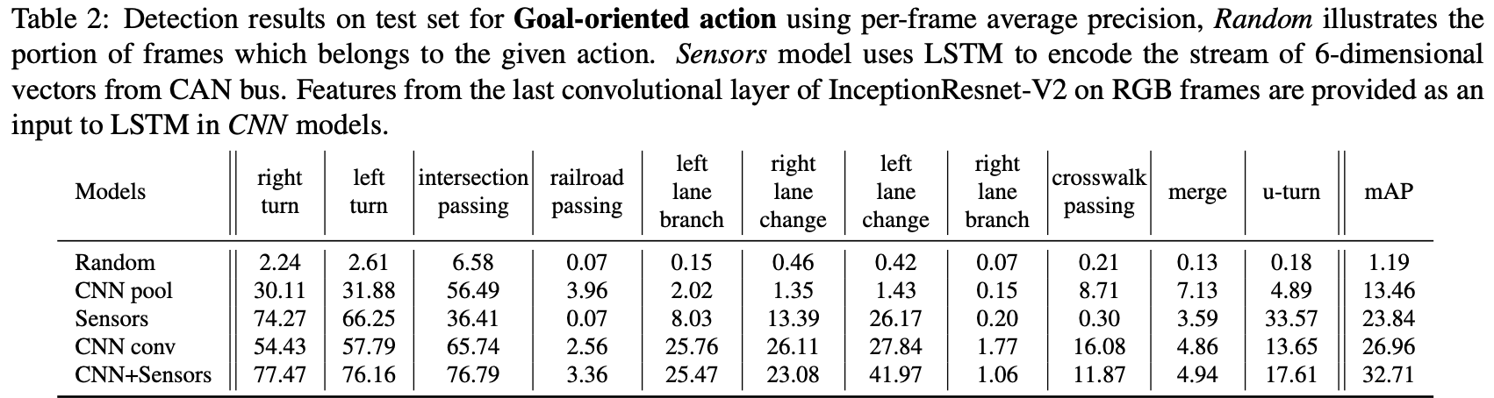
实验结果
‘CNN pool’ encodes each frame by extracting convolutional features using an InceptionResnet-V2 network and pooling them spatially to a fixed-length vector. These pooled representations of frames are sequentially fed to the LSTM to predict the behavior label.
‘Sensors’ uses only the sensor data as input to the LSTM

Slide 19
实验结果
‘CNN-conv’ is a variant of the second method: instead of spatially pooling CNN feature encodings, we used a small convnet to reduce the dimensionality of the CNN encodings of the frames before passing them through the LSTM.
‘CNN+Sensors’ method adds sensor data to the ‘CNN conv’ method

Slide 20
实验结果分析
The performance of ‘CNN pool’ is quite low. This can be attributed to the fact that information is lost by the spatial pooling operation .
‘CNN conv’ replaces pooling by a learnable conv layer and significantly increases mAP.

Slide 21
实验结果分析
Sensor measurements (brake, steering wheel, etc.) alone result in slightly better AP for simple actions like left/right turns where the information about steering wheel position can be sufficient in most of the cases.
successfully guess ‘intersection passing’ :most of them are happening in a very specific pattern: ‘deceleration/wait/acceleration’

Slide 22
实验结果分析
‘railroad passing’ this behavior type includes not only railroad crossing in the designated locations which have discriminative visual features but also tram rails crossing.
When it comes to actions like lane changes, visual information used in ‘CNN conv’ allows for proper scene interpretation, thus, improving over ‘Sensor’ model.

Slide 23
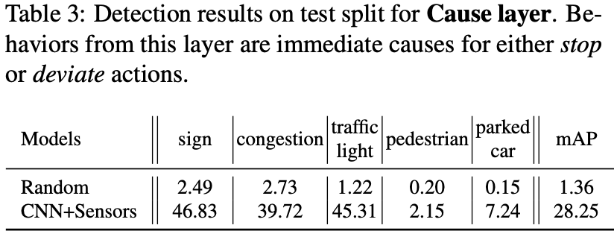
实验结果分析
First, the two classes are underrepresented in the dataset
Second, motion modeling for a short duration of cause (e.g., pedestrian) may not be captured in the base- line model (similar to railroad passing). The motion pattern of a deviate action may not be modeled effectively to detect parked car.

Slide 24
THANKS

